Slide 1
Lesson 2 – Review Day 1.4 and 1.5
I will learn about the buddy letter, digraphs, bonus letter, and word elements such as baseword and suffix.

Slide 2

Let’s learn how to read, write and spell better by building words.
TAP IT OUT!

Slide 3
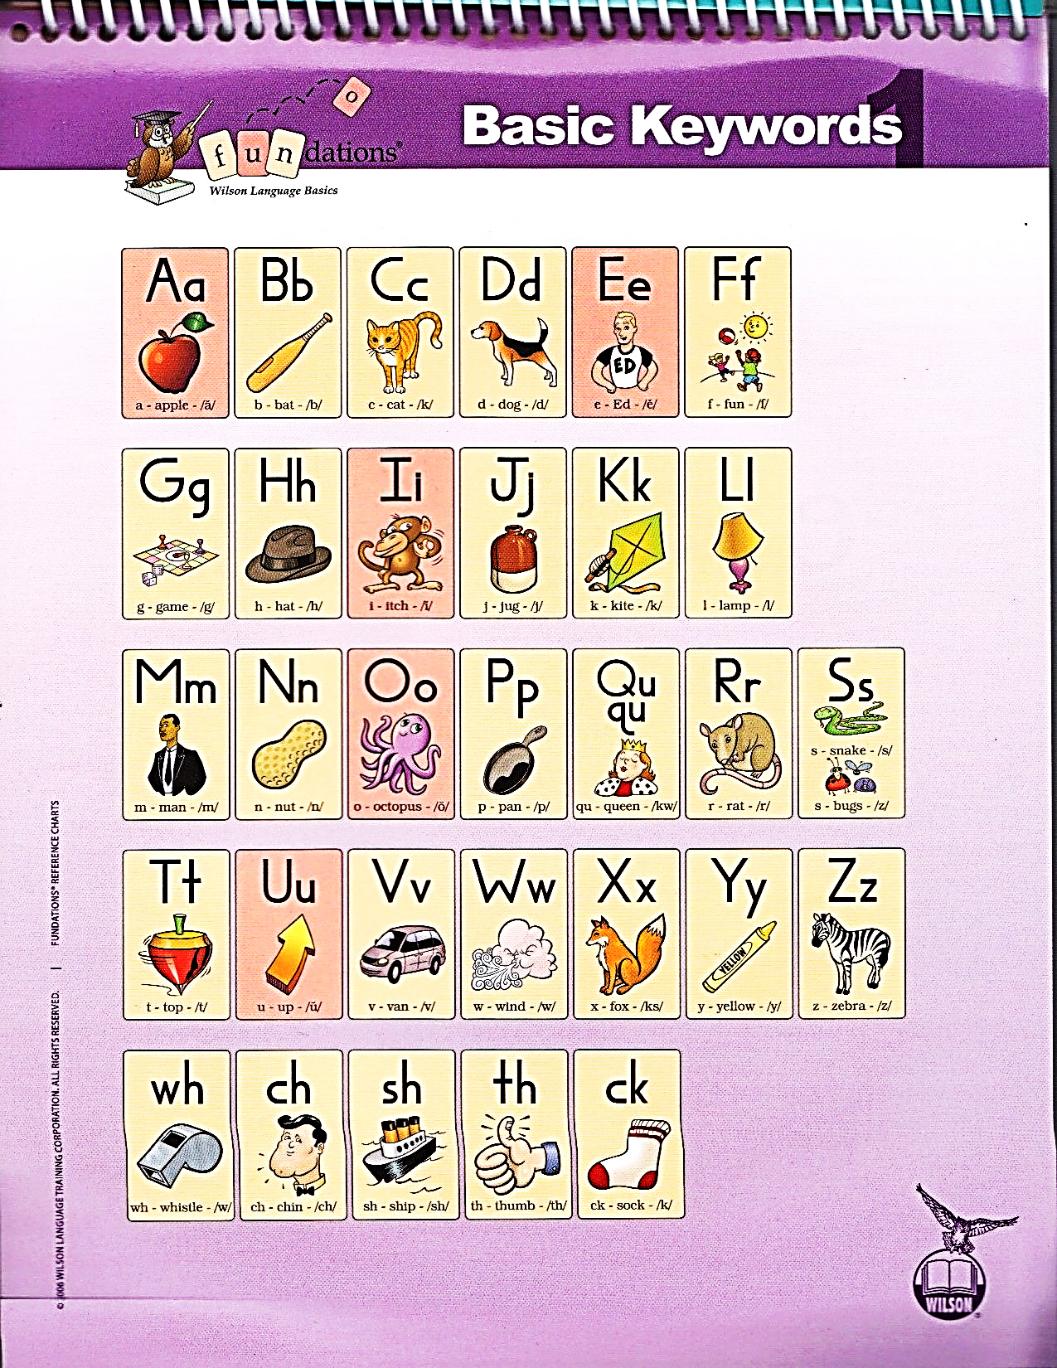
Student Notebook
pg 4
Vowels
Vowels are the most important letters, because every word and syllable needs a vowel. --- BUT, they sound so alike that we always say they we the keyword…
Echo (Clip It)
&
Draw

Slide 4
Student Notebook
pg 1
Consonants
You probably know all of this letters and their sounds but let’s make sure we are not adding any extra wrong sounds…
Echo (Clip It)
&
Draw

Slide 5
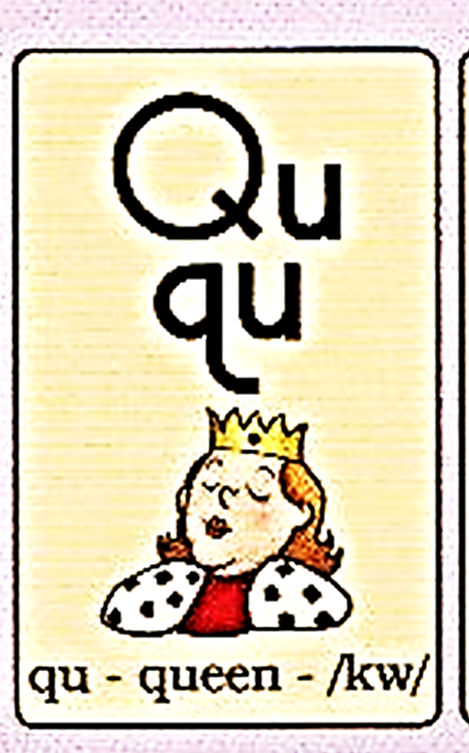
Student Notebook
pg 1
The Buddy Letter “Qu”
“q” is the only letter in the English language that will not be in a word by itself. It always needs to bring along its buddy “u”.
“Q never goes anywhere without ‘u’”
Echo (Clip It)
&
Draw

Slide 6
Student Notebook
pg 2
Digraphs
Some consonants are so stuck together that they form one sound even though there are two letters.
“A Digraph is 2-letters that make 1 sound!”

Slide 7
Student Notebook
pg 2
Bonus Letter
f
l
s
o
f
f
sh
e
l
l
m
i
s
s
z
Any 1-syllable word that ends in “f”, “l”, “s” and sometimes “z” needs a bonus letter.

Slide 8
Review 1.6
Word Elements
Student Notebook
pg 2
sh
o
p
-s
Plural - More than one
Action Verb
Suffix
-s = /s/
Baseword
1. Baseword
2. Suffix
b
u
g
-s
Plural - More than one
Action Verb
Suffix
-s
-es
-s = /z/
-s, -es
More than one (Plural)
Action Verb
Baseword
m
i
x
-es
Plural - More than one
Action Verb
Suffix
-es = /iz/
Baseword

Slide 9
a
b
c
d
e
f
ank
ang
Review Words
g
h
i
j
k
ink
ing
all
am
an
m
n
p
qu
r
onk
ong
TAP IT OUT!
Where is the Bonus Letter?
t
u
v
w
x
y
z
unk
ung
wh
ch
sh
th
ck
-s
-es
f
l
all
am
an
l
o
s
s
ild
ind
old
olt
ost

Slide 10
a
b
c
d
f
ank
ang
Review Words
g
h
i
j
k
ink
ing
all
am
an
m
n
o
p
qu
r
s
onk
ong
TAP IT OUT!
Where is the Bonus Letter?
t
u
v
w
x
z
unk
ung
wh
ch
sh
th
ck
-s
-es
f
s
all
am
an
y
e
l
l
ild
ind
old
olt
ost

Slide 11
a
b
c
d
e
f
ank
ang
Review Words
h
j
k
ink
ing
all
am
an
m
n
o
p
qu
r
s
onk
ong
TAP IT OUT!
Where is the Bonus Letter?
t
u
v
w
x
y
z
unk
ung
wh
ch
sh
th
ck
-s
-es
f
s
all
am
an
g
i
l
l
ild
ind
old
olt
ost

Slide 12
a
b
c
d
f
ank
ang
Review Words
g
i
j
k
l
ink
ing
all
am
an
m
n
o
p
qu
r
s
onk
ong
TAP IT OUT!
Nonsense
u
v
w
x
y
z
unk
ung
wh
ch
sh
th
ck
-es
f
l
s
all
am
an
h
e
t
-s
ild
ind
old
olt
ost

Slide 13
a
b
c
d
e
f
ank
ang
Review Words
g
h
i
j
k
l
ink
ing
all
am
an
m
n
o
p
qu
r
s
onk
ong
TAP IT OUT!
Where is the Welded Sound?
t
u
v
w
x
y
z
unk
ung
wh
ch
sh
th
ck
-s
-es
f
l
s
all
am
an
ild
ind
old
olt
ost

Slide 14



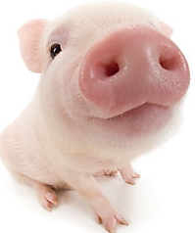
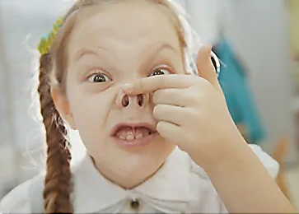

Use 2 fingers because these 2 sounds are glued together.
Welded Sounds
“Glued Sounds”
all
/ȯl/
b
all
am
/am/
Sounds that are so stuck together that they make a new sound.
h
am
Nasal Sounds
an
/an/
f
an

Slide 15
a
b
c
d
e
f
ank
ang
Welded Sounds
g
h
i
j
k
l
ink
ing
all
am
an
m
n
o
p
qu
r
s
onk
ong
TAP IT OUT!
Where is the Welded Sound?
t
u
v
x
y
z
unk
ung
wh
ch
sh
th
ck
-s
-es
f
l
s
am
an
w
all
ild
ind
old
olt
ost

Slide 16
a
b
d
e
f
ank
ang
Welded Sounds
g
h
i
j
k
l
ink
ing
all
am
an
m
n
o
p
qu
r
s
onk
ong
TAP IT OUT!
Where is the Welded Sound?
t
u
v
w
x
y
z
unk
ung
wh
ch
sh
th
ck
-s
-es
f
l
s
am
an
c
all
ild
ind
old
olt
ost

Slide 17
a
b
c
d
e
f
ank
ang
Welded Sounds
g
h
i
j
k
l
ink
ing
all
am
an
m
n
o
p
qu
r
s
onk
ong
TAP IT OUT!
Where is the Welded Sound?
u
v
w
x
y
z
unk
ung
wh
ch
sh
th
ck
-s
-es
f
l
s
am
an
t
all
ild
ind
old
olt
ost

Slide 18
a
c
d
e
f
ank
ang
Welded Sounds
g
h
i
j
k
l
ink
ing
all
am
an
m
n
o
p
qu
r
s
onk
ong
TAP IT OUT!
Where is the Welded Sound?
t
u
v
w
x
y
z
unk
ung
wh
ch
sh
th
ck
-s
-es
b
a
m
f
l
s
all
an
ild
ind
old
olt
ost
b
am

Slide 19
a
b
c
d
e
f
ank
ang
Welded Sounds
g
h
i
j
k
l
ink
ing
all
am
an
m
n
o
qu
r
s
onk
ong
TAP IT OUT!
Where is the Welded Sound?
t
u
v
w
x
y
z
unk
ung
wh
ch
sh
th
ck
-s
-es
p
a
n
f
l
s
all
am
ild
ind
old
olt
ost
p
an

Slide 20
a
b
d
e
f
ank
ang
Welded Sounds
g
h
i
j
k
l
ink
ing
all
am
an
m
n
o
p
qu
r
s
onk
ong
TAP IT OUT!
Where is the Welded Sound?
t
u
v
w
x
y
z
unk
ung
wh
ch
sh
th
ck
-s
-es
f
l
s
all
am
c
an
ild
ind
old
olt
ost

Slide 21
a
b
c
d
e
f
ank
ang
Welded Sounds
g
h
i
j
k
l
ink
ing
all
am
an
n
o
p
qu
r
s
onk
ong
TAP IT OUT!
Where is the Welded Sound?
t
u
v
w
x
y
z
unk
ung
wh
ch
sh
th
ck
-s
-es
f
l
s
all
am
m
an
ild
ind
old
olt
ost

Slide 22
a
b
c
e
f
ank
ang
Welded Sounds
g
h
i
j
k
l
ink
ing
all
am
an
m
n
o
p
qu
r
s
onk
ong
TAP IT OUT!
Where is the Welded Sound?
t
u
v
w
x
y
z
unk
ung
wh
ch
sh
th
ck
-s
-es
f
l
s
all
an
d
am
ild
ind
old
olt
ost

Slide 23
a
b
c
d
e
f
ank
ang
Welded Sounds
g
h
i
j
k
l
ink
ing
all
am
an
m
n
o
p
qu
r
s
onk
ong
TAP IT OUT!
Where is the Welded Sound?
t
u
v
w
x
y
z
unk
ung
wh
ch
sh
ck
-s
-es
f
l
s
all
am
th
an
ild
ind
old
olt
ost

Slide 24
a
b
c
d
e
f
ank
ang
Welded Sounds
g
h
i
j
k
l
ink
ing
all
am
an
m
n
o
p
qu
r
s
onk
ong
TAP IT OUT!
Where is the Welded Sound?
t
u
v
w
x
y
z
unk
ung
wh
ch
sh
ck
-s
-es
f
l
s
all
am
th
an
ild
ind
old
olt
ost

Slide 25
a
b
c
d
e
f
ank
ang
Welded Sounds
g
h
i
j
k
l
ink
ing
all
am
an
m
n
o
p
qu
r
s
onk
ong
TAP IT OUT!
Where is the Welded Sound?
t
u
v
w
x
y
z
unk
ung
wh
ch
sh
th
ck
-s
-es
f
l
s
all
am
an
ild
ind
old
olt
ost

Slide 26
3. Word Cards Time!
TAP IT OUT!

Slide 27
4. Charting Time!
TAP IT OUT!

Slide 28
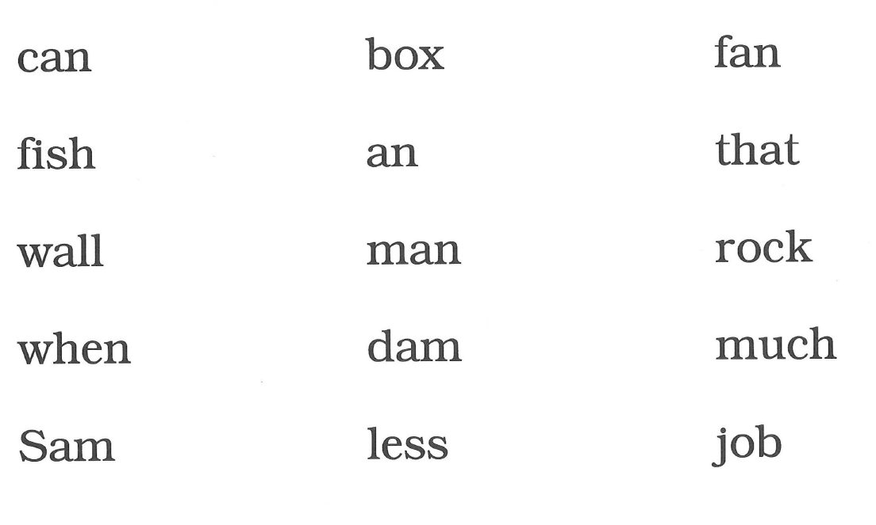

Slide 29
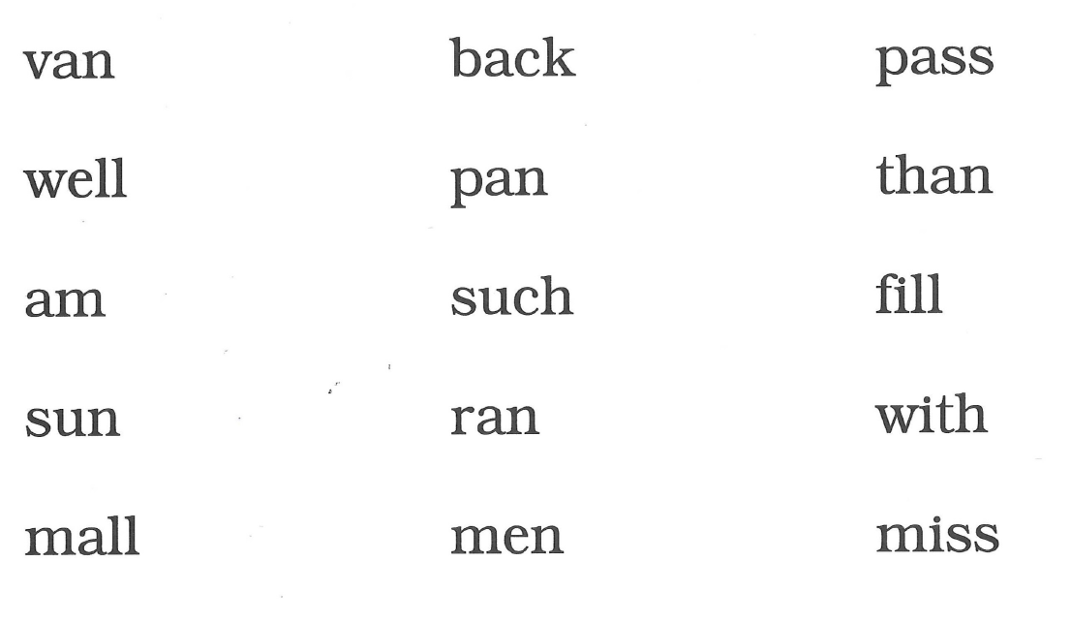

Slide 30
5. Sentence Reading Time!
TAP IT OUT!

Slide 31
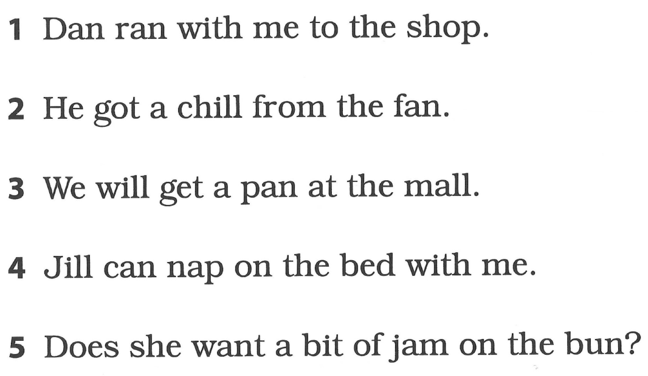
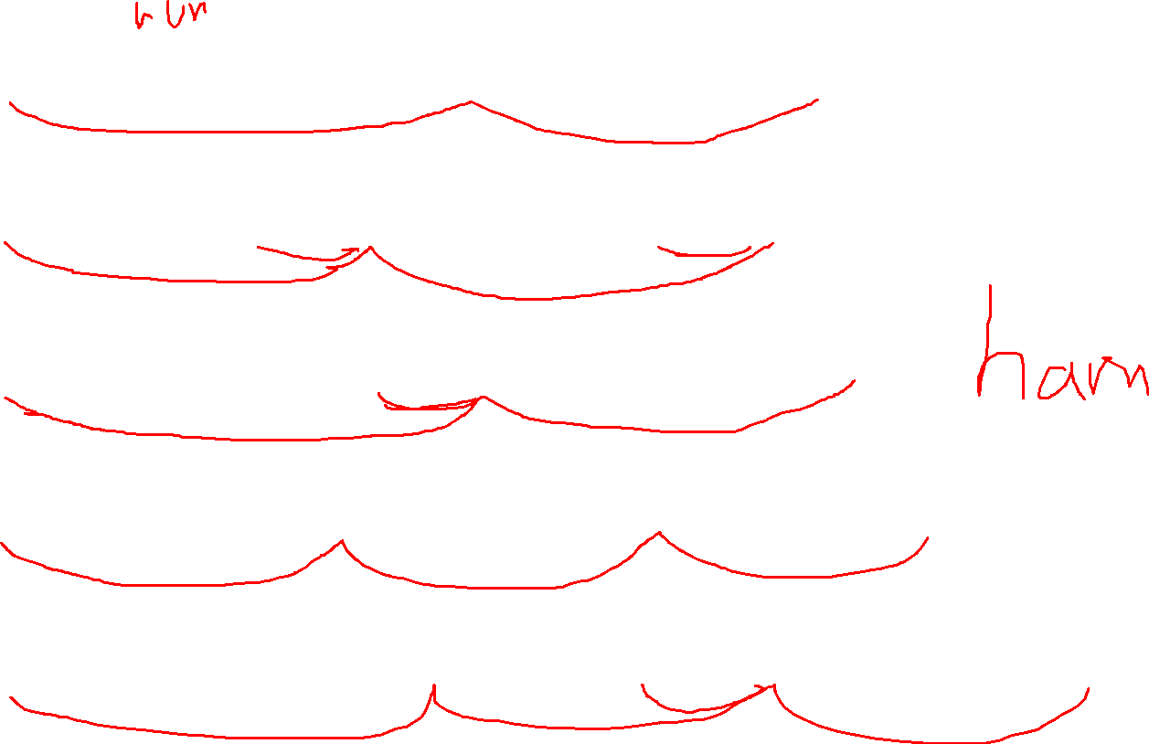

Slide 32
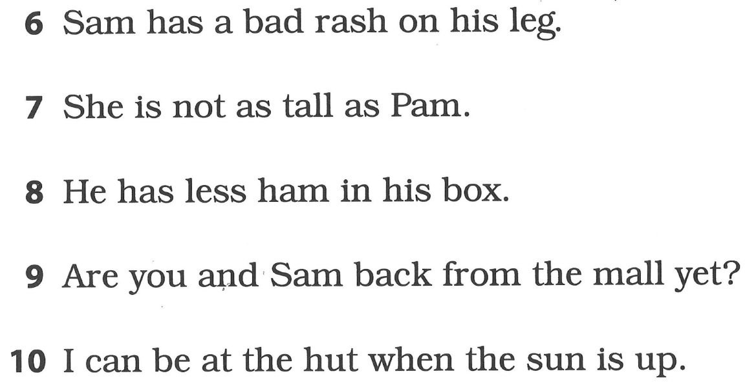
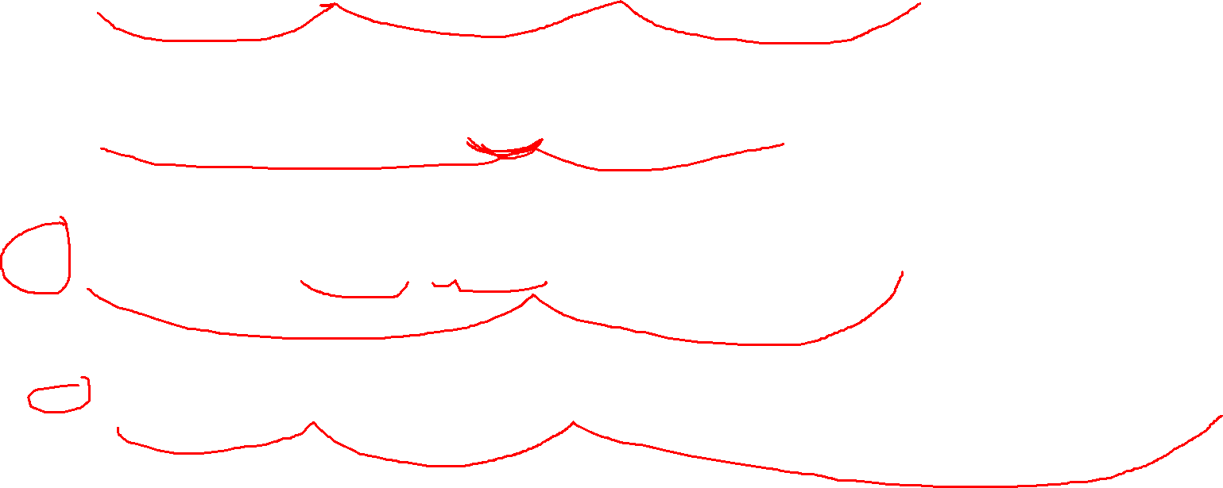

Slide 33

Have a great day!

Slide 34
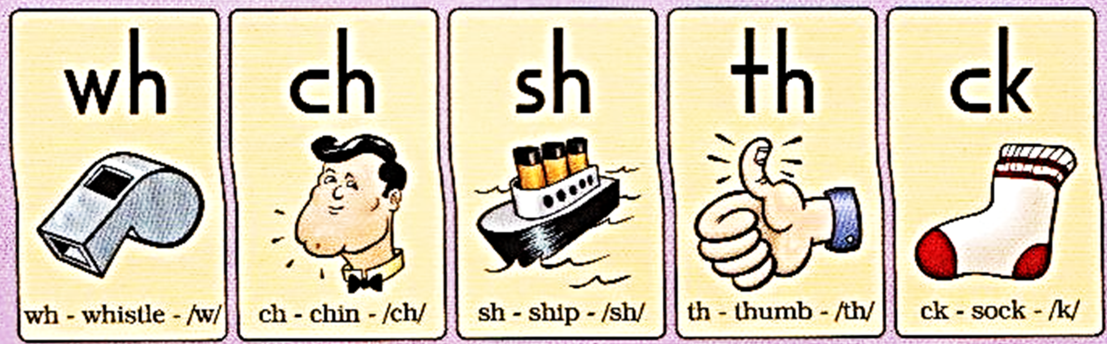
a
b
c
d
e
ank
ang
Digraphs
g
h
j
k
l
ink
ing
m
n
o
p
qu
r
s
onk
ong
t
unk
ung
TAP IT OUT!
u
v
w
x
y
z
ch
sh
th
ck
-s
-es
Where is the Digraph?
Bonus Letter?
l
s
all
am
an
wh
i
f
f
ild
ind
old
olt
ost

Slide 35
a
b
c
d
f
ank
ang
Bonus Letter
g
h
i
j
k
ink
ing
f
l
s
z
m
n
o
p
qu
r
onk
ong
t
unk
ung
TAP IT OUT!
u
v
w
x
y
z
Where is the Bonus Letter?
wh
ch
sh
th
ck
-s
-es
l
e
s
s
f
l
all
am
an
ild
ind
old
olt
ost

Slide 36
a
b
c
d
e
f
ank
ang
Bonus Letter
g
j
k
ink
ing
f
l
s
z
m
n
o
p
qu
r
s
onk
ong
t
unk
ung
TAP IT OUT!
u
v
w
x
y
z
Where is the Bonus Letter?
wh
ch
sh
th
ck
-s
-es
f
s
all
am
an
h
i
l
l
ild
ind
old
olt
ost

Slide 37
a
b
c
d
e
f
ank
ang
Bonus Letter
g
h
i
j
k
l
ink
ing
f
l
s
z
n
o
p
qu
r
onk
ong
t
unk
ung
TAP IT OUT!
v
w
x
y
z
Where is the Bonus Letter?
wh
ch
sh
th
ck
-s
-es
f
l
s
all
am
an
s
u
m
ild
ind
old
olt
ost

Slide 38
6. Quick Drill in Reverse
(Magnetic Journals)
TAP IT OUT!

Slide 39
7. Spelling
(Magnetic Journals)
Say
Say w/o Suffix
Tap
Spell
Build as you Spell
Scoop and Read
Spell it Back
TAP IT OUT!

Slide 40
a
b
c
d
e
f
ank
ang
Say
Say w/o Suffix
Tap
Spell
Build as you Spell
Scoop and Read
Spell it Back
Spelling!
g
h
j
k
ink
ing
TAP IT OUT!
m
n
o
p
r
s
onk
ong
t
u
v
w
x
y
z
unk
ung
Where is the Bonus Letter?
wh
ch
sh
th
ck
-s
-es
qu
i
l
l
f
s
all
am
an
ild
ind
old
olt
ost

Slide 41
a
b
c
d
e
f
ank
ang
Say
Say w/o Suffix
Tap
Spell
Build as you Spell
Scoop and Read
Spell it Back
Spelling!
g
h
j
k
l
ink
ing
TAP IT OUT!
m
n
o
qu
r
s
onk
ong
t
u
v
w
x
y
z
unk
ung
ch
sh
th
ck
-s
-es
Where is the Digraph Blend?
f
l
s
all
am
an
wh
i
p
ild
ind
old
olt
ost

Slide 42
a
b
c
d
e
f
ank
ang
Say
Say w/o Suffix
Tap
Spell
Build as you Spell
Scoop and Read
Spell it Back
Spelling!
g
h
i
j
k
l
ink
ing
TAP IT OUT!
m
n
p
qu
r
s
onk
ong
t
u
v
w
x
y
z
unk
ung
wh
ch
th
-s
-es
Where is the Digraph Blend?
sh
o
ck
f
l
s
all
am
an
ild
ind
old
olt
ost

Slide 43
c
d
e
f
ank
ang
Say
Say w/o Suffix
Tap
Spell
Build as you Spell
Scoop and Read
Spell it Back
Spelling!
g
h
i
j
k
l
ink
ing
TAP IT OUT!
m
n
o
p
qu
r
s
onk
ong
u
v
w
x
y
z
unk
ung
wh
ch
sh
th
ck
-es
Where is the Digraph Blend?
b
a
t
-s
f
l
s
all
am
an
ild
ind
old
olt
ost

Slide 44
a
b
c
d
e
f
ank
ang
Say
Say w/o Suffix
Tap
Spell
Build as you Spell
Scoop and Read
Spell it Back
Spelling!
g
h
j
k
l
ink
ing
TAP IT OUT!
n
o
p
qu
r
s
onk
ong
t
u
v
w
y
z
unk
ung
wh
ch
sh
th
ck
-s
Where is the Digraph Blend?
m
i
x
-es
f
l
s
all
am
an
ild
ind
old
olt
ost

Slide 45
a
b
c
d
e
f
ank
ang
Say
Say w/o Suffix
Tap
Spell
Build as you Spell
Scoop and Read
Spell it Back
Spelling!
g
h
i
j
k
l
ink
ing
TAP IT OUT!
m
n
o
p
qu
r
s
onk
ong
t
u
v
w
x
y
z
unk
ung
wh
ch
sh
th
ck
-s
-es
Where is the Digraph Blend?
f
l
s
all
am
an
ild
ind
old
olt
ost

Slide 46
Use your journal.
Name
Substep 1.6
Lesson Number 1
Date: 9/29/20
Dictation TIME!
TAP IT OUT!

Slide 47
a
b
c
d
e
f
ank
ang
Say
Say w/o Suffix
Tap
Spell
Build as you Spell
Scoop and Read
Spell it Back
Spelling!
g
h
i
j
k
l
ink
ing
TAP IT OUT!
m
n
o
p
qu
r
s
onk
ong
t
u
v
w
x
y
z
unk
ung
wh
ch
sh
th
ck
-s
-es
Where is the Digraph Blend?
f
l
s
all
am
an
ild
ind
old
olt
ost

Slide 48
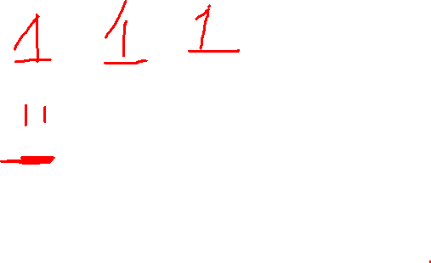
a
b
c
d
e
f
ank
ang
Digraphs!
g
h
j
k
l
ink
ing
TAP IT OUT!
m
n
o
qu
r
s
onk
ong
TAP IT OUT!
t
u
v
w
x
y
z
unk
ung
wh
ch
th
ck
-s
-es
f
l
s
all
am
an
sh
i
p
ild
ind
old
olt
ost

Slide 49
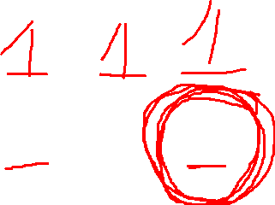
a
b
c
d
f
ank
ang
Digraphs!
g
h
i
j
k
l
ink
ing
TAP IT OUT!
m
n
o
p
qu
r
s
onk
ong
t
u
v
w
x
y
z
unk
ung
wh
sh
th
-s
-es
f
l
s
all
am
an
ch
e
ck
ild
ind
old
olt
ost

Slide 50
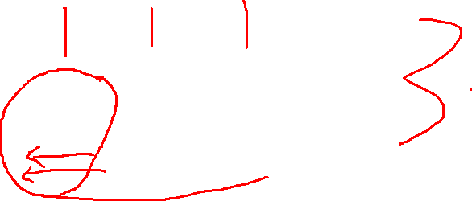
a
b
c
d
e
f
ank
ang
Digraphs!
g
h
j
k
l
ink
ing
TAP IT OUT!
m
n
o
qu
r
s
onk
ong
t
u
v
w
x
y
z
unk
ung
ch
sh
th
ck
-s
-es
f
l
s
all
am
an
wh
i
p
ild
ind
old
olt
ost

Slide 51
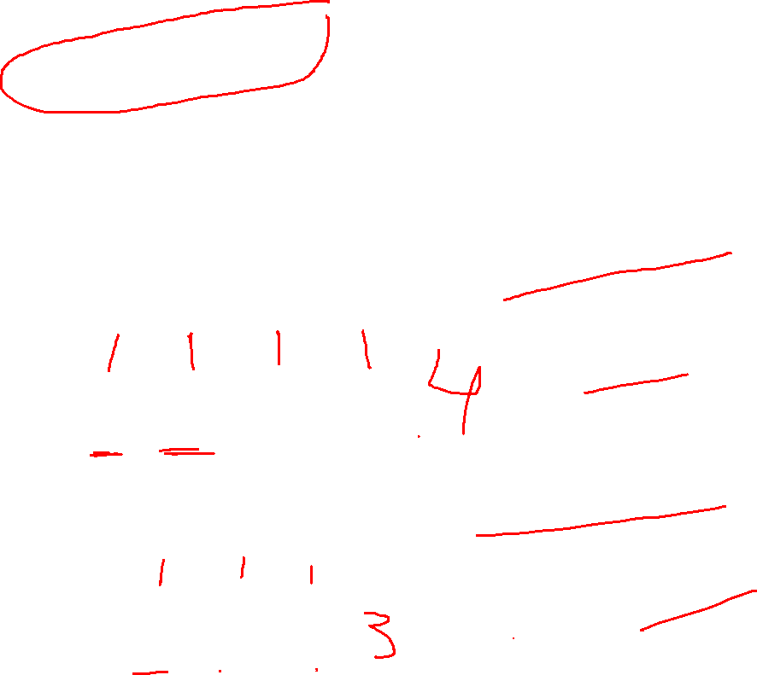
a
b
c
d
e
f
ank
ang
Consonant Blends!
g
h
j
k
ink
ing
m
n
o
qu
r
onk
ong
TAP IT OUT!
Blends and Digraphs are NOT the same.
t
u
v
w
x
y
z
unk
ung
wh
ch
sh
th
ck
-s
-es
s
l
i
p
f
l
s
all
am
an
ild
ind
old
olt
ost
sh
i
p

Slide 52
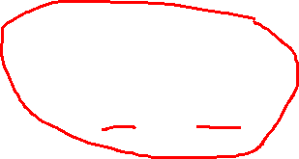
b
c
d
e
f
ank
ang
Digraphs!
g
h
i
j
k
l
ink
ing
TAP IT OUT!
m
o
qu
r
onk
ong
t
u
v
w
x
y
z
unk
ung
wh
ch
sh
th
ck
-s
-es
Where is the Blend?
s
n
a
p
f
l
s
all
am
an
ild
ind
old
olt
ost

Slide 53

a
b
c
d
f
ank
ang
Digraphs!
g
h
i
j
k
l
ink
ing
TAP IT OUT!
m
o
p
qu
r
onk
ong
u
v
w
x
y
z
unk
ung
wh
ch
sh
th
ck
-s
-es
Where is the Blend?
f
l
s
all
am
an
s
e
n
t
ild
ind
old
olt
ost

Slide 54
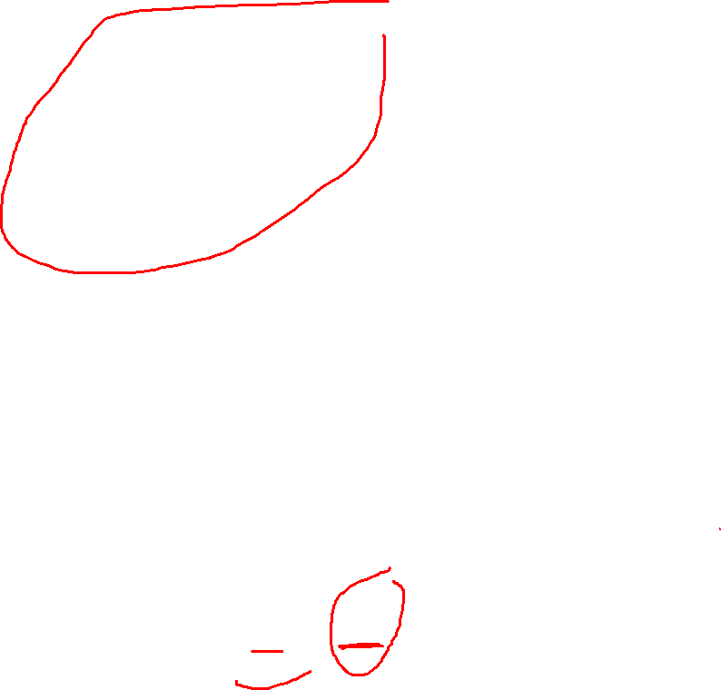
a
b
c
d
e
f
ank
ang
Digraph Blends!
g
h
i
j
k
ink
ing
m
o
p
qu
r
s
onk
ong
TAP IT OUT!
t
v
w
x
y
z
unk
ung
wh
sh
th
ck
-s
-es
Where is the Digraph Blend?
f
l
s
all
am
an
l
u
n
ch
ild
ind
old
olt
ost

Slide 55

a
b
c
f
ank
ang
Digraph Blends!
g
h
i
j
k
l
ink
ing
m
n
o
p
qu
s
onk
ong
t
unk
ung
TAP IT OUT!
u
v
w
x
y
z
wh
ch
th
ck
-s
-es
Where is the Digraph Blend?
f
l
s
all
am
an
sh
r
e
d
ild
ind
old
olt
ost

Slide 56
a
b
c
d
e
f
ank
ang
Digraph Blends!
g
h
i
j
k
l
ink
ing
m
n
o
p
qu
r
s
onk
ong
t
unk
ung
TAP IT OUT!
u
v
w
x
y
z
wh
ch
sh
th
ck
-s
-es
Where is the Digraph Blend?
f
l
s
all
am
an
ild
ind
old
olt
ost

Slide 57
Let’s Build Some Words with Digraphs!
Magnetic Journal
Dictate
Tap
Spell
Build
TAP IT OUT!

Slide 58
Unit 2 Day 1 Phrases:
from the dish
rush on deck
lack of fun
then they shop
are not thick
Let’s read fluently!

Slide 59
Unit 2 Day 1 Phrases:
in the back
shop was posh
hush the mob
rock is thin
have such fun
Let’s read fluently!

Slide 60
Let’s Build Some Words with Digraphs!
Magnetic Journal
Dictate
Tap
Spell
Build
TAP IT OUT!

Slide 61
Title and Content Layout with List
Add your first bullet point here
Add your second bullet point here
Add your third bullet point here

Slide 62
Two Content Layout with Table
First bullet point here
Second bullet point here
Third bullet point here
Class | Group 1 | Group 2
Class 1 | 82 | 95
Class 2 | 76 | 88
Class 3 | 84 | 90

Slide 63
Title and Content Layout with SmartArt
Step 1 Title
Step 2 Title
Step 3 Title
Step 4 Title
Step 5 Title

Slide 64
a
b
c
d
e
f
ank
ang
Digraph Blends!
g
h
i
j
k
l
ink
ing
m
n
o
p
qu
r
s
onk
ong
t
unk
ung
TAP IT OUT!
u
v
w
x
y
z
wh
ch
sh
th
ck
-s
-es
Where is the Digraph Blend?
f
l
s
all
am
an
ild
ind
old
olt
ost

Slide 65
Section Header Layout
Subtitle

Slide 66
Picture with Caption Layout
Caption

Slide 67
Add a Slide Title - 1

Slide 68
Add a Slide Title - 2

Slide 69
Add a Slide Title - 3

Slide 71
Add a Slide Title - 4

